Slide 1
Numericals on IC engine

Slide 2
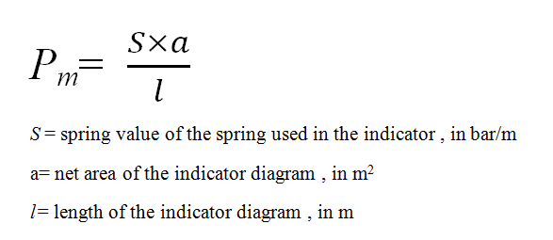
Relevant formulae in IC engine
Mean effective pressure,P_{m}
It is the mean or average pressure acting on the piston during power stroke

Slide 3
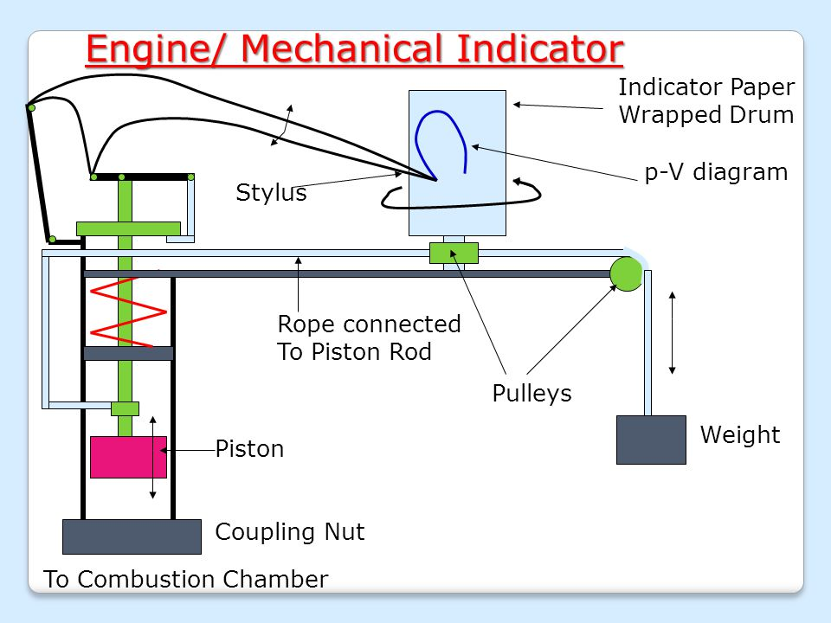

Slide 4
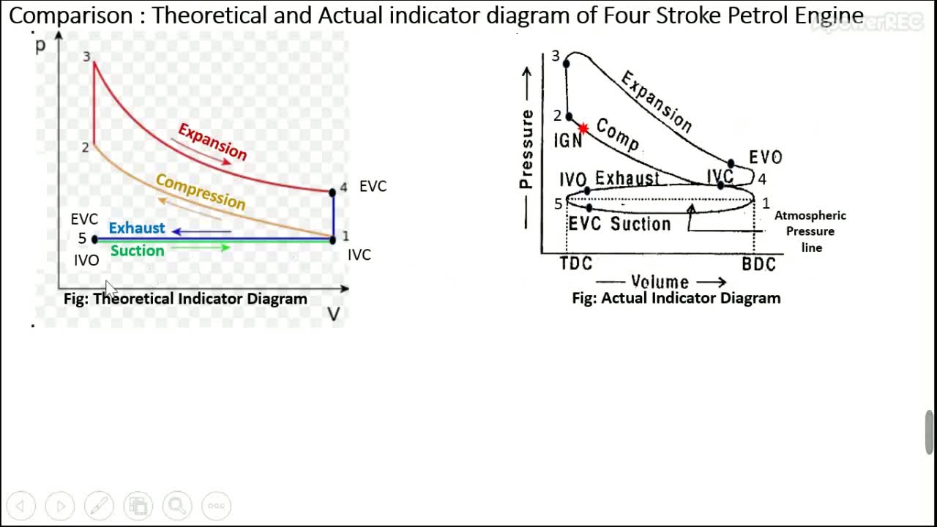

Slide 5
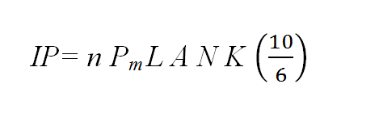
Indicated power, IP (in kW)
Total power developed inside the engine cylinder due to combustion of fuel
where, n= no. of cylinders
P_{m} = mean effective pressure, in bars L= length of cylinder or stroke, in m
A=area of cross section of cylinder, in m²
= (πd²)/4, d= diameter of cylinder or piston or bore, in m
N= speed of engine in rpm
K= ½ for 4-s engine
= 1 for 2-s engine

Slide 6
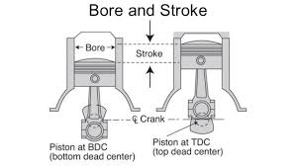
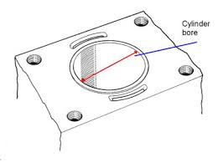

Slide 7
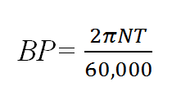
Brake power ,BP, in kW
Net power available at the crankshaft for doing useful work
where N= speed of engine in rpm T= torque of engine in N-m
Torque can be measured using i) rope brake dynamometer or ii) belt dynamometer

Slide 8
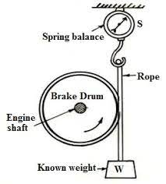
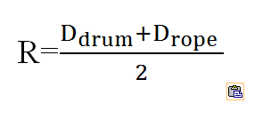
Measuring torque using rope brake dynamometer
T= (W-S) R
(W-S) is effective brake load
R is effective radius,measured from centre of pulley to
centre of rope
W= suspended weight ,in N
S= spring balance reading in N

Slide 9
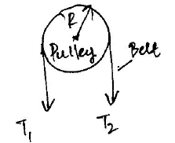
Measuring torque using belt dynamometer Torque, T= (T₁-T₂ ) R T₁₌ tension on tight side, in m T₂₌ tension on slack side, in m R= radius of pulley

Slide 10
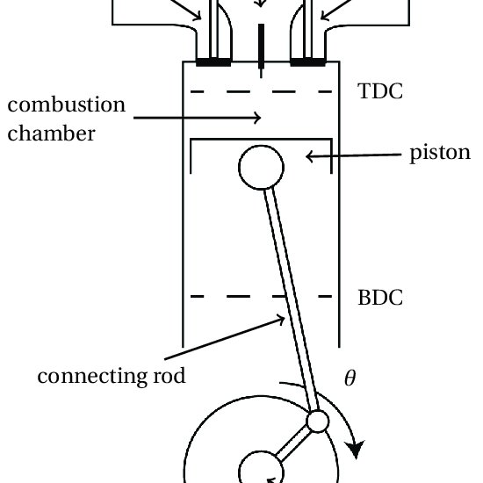
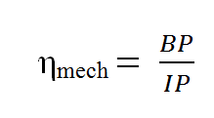
Frictional Power, FP
FP (in KW )= IP-BP
Mechanical Efficiency,

Slide 11
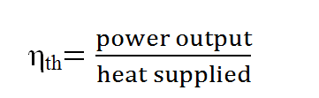

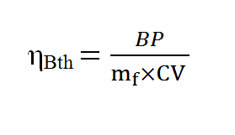
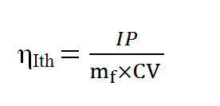
Thermal efficiency
power output in kW
m_{f} = mass of fuel flowing in kg/s CV = calorific value of fuel in kJ/kg

Slide 12
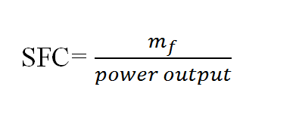
Specific fuel consumption
m_{f} = mass of fuel flowing in kg/h , power output is in kW
It could be either IP or BP

Slide 13
Numericals
Problem 1:
A four stroke diesel engine has a piston diameter 250mm and stroke 400mm. The mean effective pressure is 04 bars and speed is 500 rpm. The diameter of brake drum is 1000mm and the effective brake load is 400N.
Find IP,BP and FP

Slide 14
Solution:
d= 250mm L= 400mm P_{m} = 4 bars N= 500 rpm
=0.25 m = 0.4 m
IP= (1) (4) (0.4)( π* 0.25² /4 ) (500)(1/2) (10/6)
IP = 32.67 kW
BP= (2 π N T)/ 60,000
T= (W-S) R
= ( 400) 0.5 = 200N-m
BP= (2 π * 500* 200)/ 60,000
BP= 10.47 kW
FP= IP-BP =32.67 - 10.47
FP= 22.20 kW

Slide 15
Problem 2:
A single cylinder 4-s engine runs at 1000rpm and has a bore of 115 mm and stroke of 140mm. Brake load is 60N at 600mm radius and mechanical efficiency is 80%.
Calculate the brake power and mean effective pressure

Slide 16
Solution:
4s engine, k=1/2 N=1000rpm
d=115mm=0.115m L= 140mm=0.14m
(W-S) = 60N R= 600mm=0.6m η_{mech} = 0.8
Brake Power,BP = (2 π N T)/ 60,000
T= (W-S)R= 60 *0.6 = 36N-m
BP= (2 π * 1000* 36)/60,000
BP= 3.77 kW
To find mean effective pressure, P_{m}
Now,
η_{mech} = 0.8= BP/IP

Slide 17
IP= BP/0.8
IP= 3.77/0.8
IP= 4.71 kW
Now, IP = n P_{m} L A N K(10/6)
P_{m} = (IP) / {n L A N K(10/6)}
P_{m} = (4.71) / { 1*0.14* (π *o.115² /4)*1000*1/2*(10/6)}
P_{m} =4 bars

Slide 18
Problem 3:
Following data are collected from a 4s-single cylinder oil engine at full load. Bore= 200mm, stroke=280mm, speed=300rpm, indicated mean effective pressure=5.6 bars, torque on the brake drum=250N-m, oil consumed=4.2kg/h and calorific value of oil=41,000kJ/kg. Determine mechanical efficiency, indicated thermal efficiency and brake thermal efficiency

Slide 19
Solution:
IP= n P_{m} L AN K (10/6)
= (1) (5.6) (0.28) * (π * 0.2²)/4 * 300*(1/2)(10/6)
IP= 12.31 k W
BP = (2 π N T)/ 60,000
BP= ( 2 π * 300* 250) / 60,000
BP= 7.85 k W
η_{mech} = 7.85/12.31 = 0.638
η_{Ith} = (IP)/( m_{f} * CV) ,
m_{f} = (4.2/3600)=0.00116
η_{Ith} = (12.31) / ( 0.00116* 41,000)
η_{Ith} = 0.257

Slide 21
Problem 4:
A 4-s petrol engine delivers a power of 35kW with a mechanical efficiency of 80% . The fuel consumed by the engine is 0.4 kg per KW-h of the power developed. Calculate indicated power, friction power , brake thermal efficiency, indicated thermal efficiency and fuel consumption per hour. If the air-fuel ratio is 14:1, calculate the air consumption per hour. The heating value of the fuel is 43,000 kJ/kg

Slide 22
Solution:
η_{mech} = BP/IP = 0.8
BP= 35kW
Therefore, IP= (35/0.8)= 43.75kW
FP= IP-BP =43.75-35 =8.75kW
To find m_{f}
BSFC = (m_{f} / BP), m_{f} in kg/h
0.4 = (m_{f} / 35) , m_{f} = 14kg/h or 3.88 x 10⁻³ kg/s

Slide 23
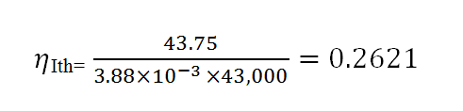
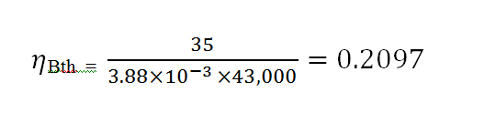

Slide 24
A/F= 14: 1
m_{a} / m_{f} = 14: 1
m_{a} = 14 x 14 = 196 kg/h

Slide 25

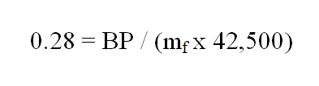
Problem 5:
Calculate the brake specific fuel consumption
of a diesel engine having a brake thermal
efficiency of 28% . The calorific value of fuel is
42,500 kJ/kg
Solution:
BSFC= (m_{f})/ BP, m_{f} in kg/h

Slide 26
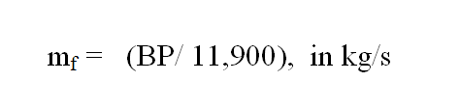
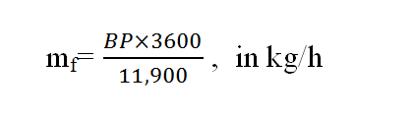

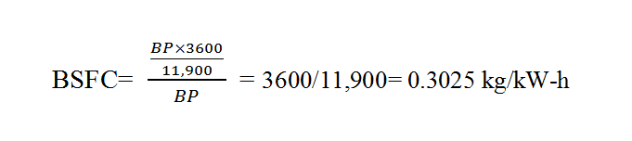

Slide 27
Problem 6:
A single cylinder, four stroke engine develops indicated power of 30kW at 300rpm. The indicated mean effective pressure is 6 bars. The piston speed is 180m/min. Determine the stroke and diameter of the cylinder. Also find the brake specific fuel consumption, if the mechanical efficiency is 80% and indicated thermal efficiency is 30% , CV of diesel is 40,000 kJ/kg

Slide 28
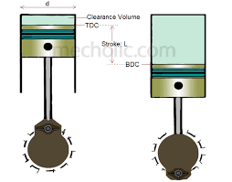
Solution:
n=1 k=1/2 IP= 30kW N=300 rpm
P_{m} =6 bars , avg. piston speed= 180m/min
η_{mech} = 0.8 η_{Ith} = 0.3 CV = 40000kJ/kg
Now, piston speed= 2LN , in m/min
180 = 2 L* 300 , L= 0.3 m
IP=nP_{m} L A N K (10/6)
30= (1) (6) (0.3)( πd² /4) (300)(1/2)(10/6)
d=0.28 m

Slide 29
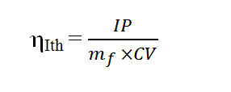
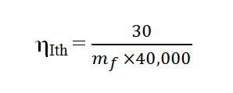
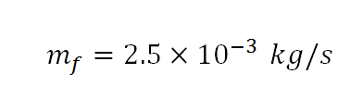

To find BSFC
η_{mech} = 0.8 , BP= 0.8 * 30= 24kW
BSFC= ( m_{f} / BP) , m_{f} in kg/h

Slide 30
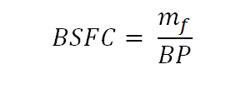
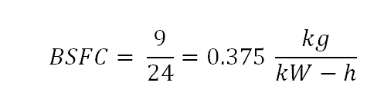

Slide 31
Problem 7:
A single cylinder 4-s IC engine has a swept volume of 6 litres and runs at a rated speed of 300 rpm. At full load , the torque developed was measured with a belt dynamometer whose pulley diameter is 1m. The tension in tight side and slack side of the belt is 700N and 300N respectively. 4kg of fuel was consumed in one hour. The indicated mean effective pressure is 6 bars and CV of fuel is 42,000kJ/kg.
Calculate the brake power, indicated power , mechanical efficiency, indicated thermal efficiency, brake thermal efficiency and brake specific fuel consumption

Slide 32
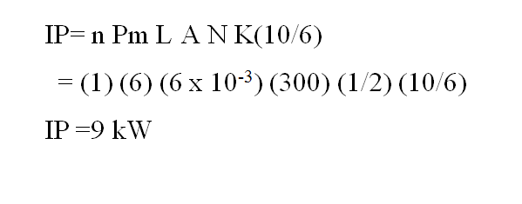
Solution:
n =1 , k=1/2 , V_{s} = 6litres , 6* 10⁻³ m³ , N=300 rpm
T₁ = 700N and T₂ = 300N, R= 0.5 m
P_{m} =6 bars m_{f} = 4kg/h CV= 42,000kJ/kg

Slide 33
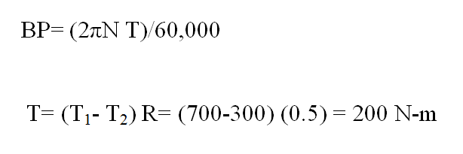


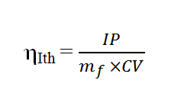
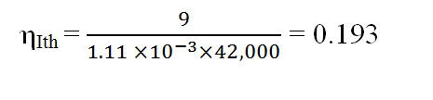

Slide 34
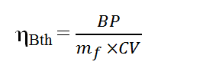
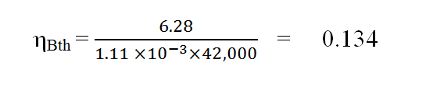
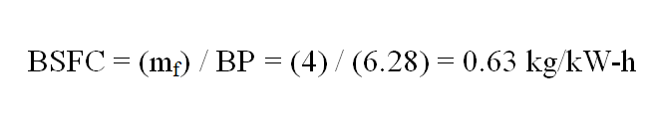

Slide 35
Problem 8:
A diesel engine develops 5 kW. Its indicated thermal efficiency is 30% and mechanical efficiency is 75% . Estimate the fuel consumption of engine in a) kg/h and b) litres/h . Also find a) ISFC and b) BSFC, take calorific value of fuel as 42,000 kJ/kg and specific gravity of fuel as 0.87

Slide 36
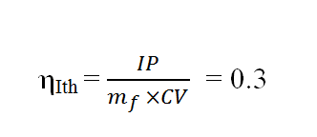


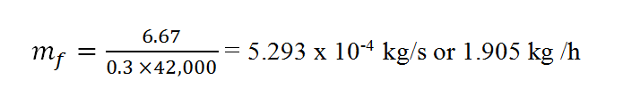
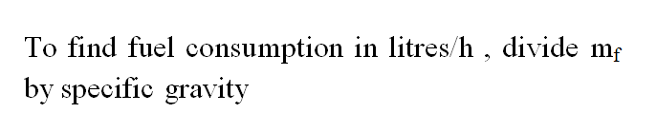
Solution:
BP=5kW

Slide 37
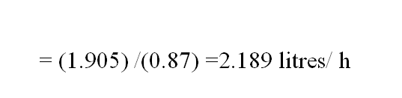
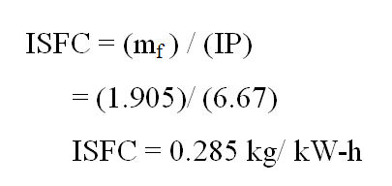
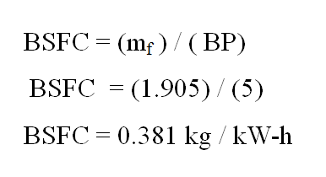

Slide 38
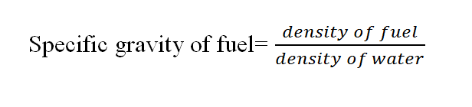

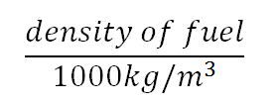






Slide 39
Problem 9:
An engine develops 50kW of power while running at full load with a mechanical efficiency of 80% . Calculate the frictional power. What will be the mechanical efficiency of the engine at half load, if the friction remains the same

Slide 40
Solution:
BP= 50kW
η_{mech =} 0.8
IP = 50 / 0.8= 62.5 kW
FP= IP- BP = 12.5kW
At half load , BP= 25 kW
IP= BP + FP = 25 + 12.5= 37.5 kW
η_{mech} = ( 25) / ( 37.5) =0.67

